Slide 1
Navigation
https://learn.microsoft.com/en-us/windows/apps/design/controls/navigationview

Slide 2
Types of navigation
Windows => Activate
Windows (Shell) => Frame as Container
Multiple Pages
Frame.Navigate (inside Pages)

Slide 3
Multiple windows example
Logi(Window) > Dashboard (Window)
Activated: show ProductsPage > AddProductPage
GoBack

Slide 4
Data passing between windows & pages
Constructor’s parameters

Slide 5
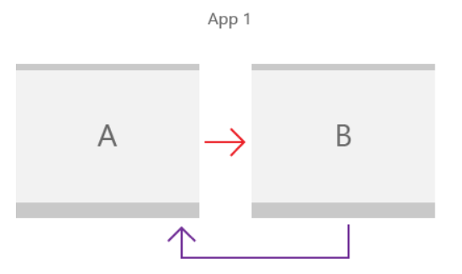
Basic 2 Pages
Peer-to-peer navigation between two pages - Windows apps | Microsoft Learn

Slide 6
Basic ideas
Use Frame to navigate between Pages
Navigation methods
Navigate
GoBack / GoForward
Properties
BackStack / ForwardStack
BackStackDepth

Slide 7
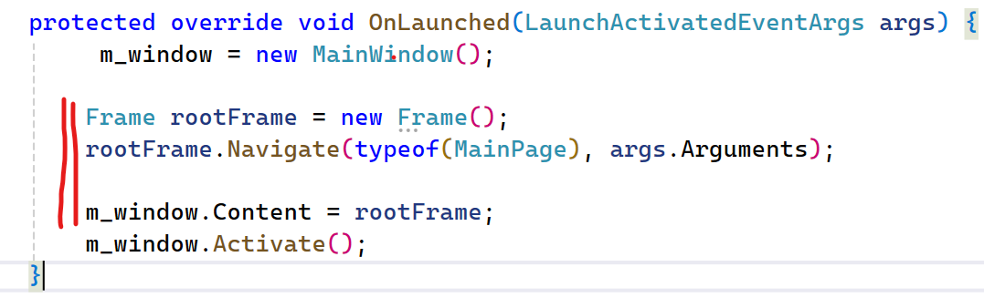
Enable navigation - App.xaml.cs

Slide 8
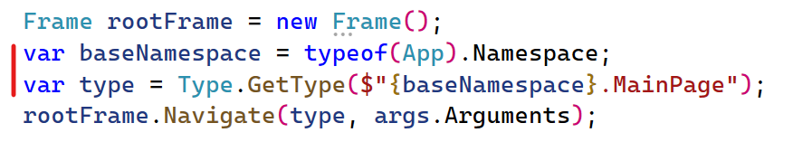
Navigate to another Page using string
Basic ideas: Using full namespace name
For example:
If the base namespace is “MyProject”
Then the full name of the Page MainPage is
“MyProject.Mainpage”

Slide 9
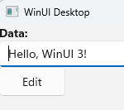
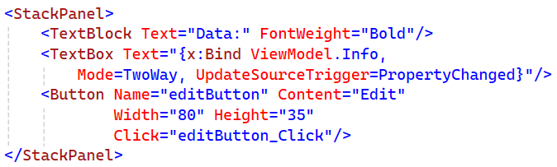
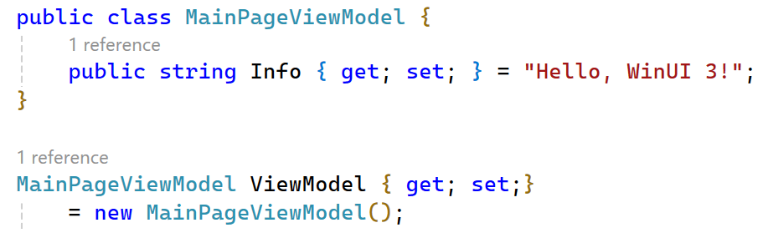
Prepare the MainPage

Slide 10
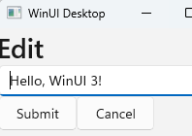
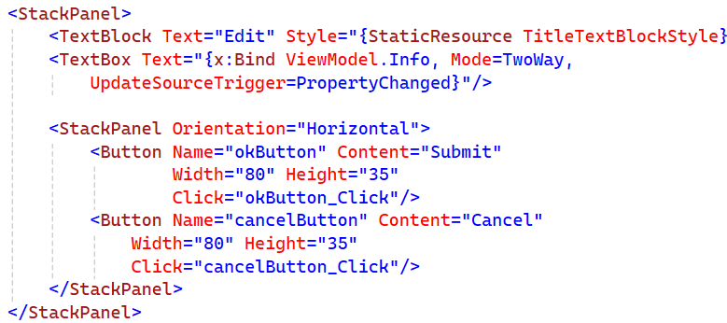
Prepare the EditPage

Slide 11
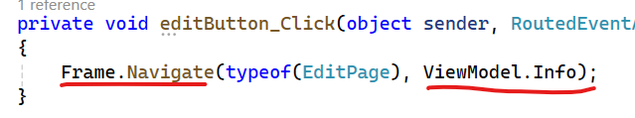
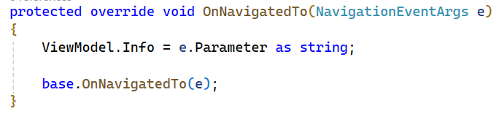
Passing data to another Page - Basic ideas
Use the second parameter of the function Navigate
In the destination page, handle OnNavigatedTo

Slide 12
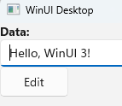
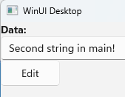
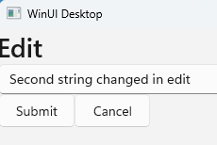
Simple flow (not good)
We should see that, not this

Slide 13
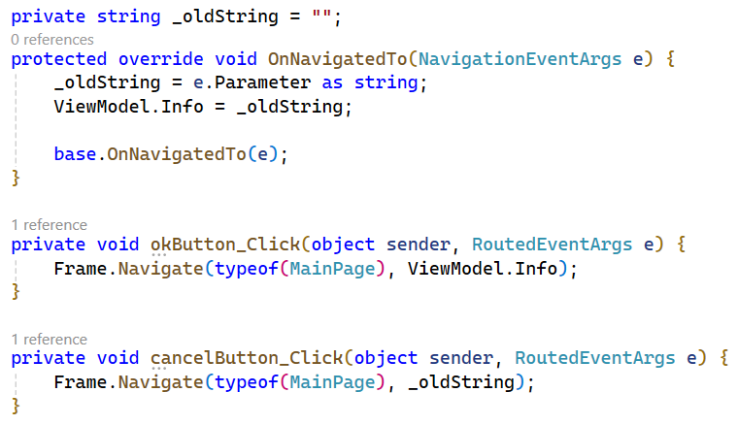
Passing data back & forth

Slide 14
How about passing an object rather than a string?
Problem?
Solution: IClonable

Slide 15
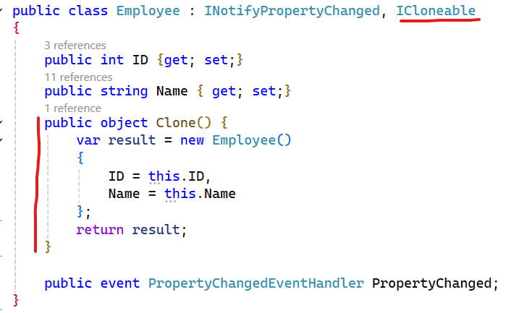
Make the Employee class Cloneable

Slide 16
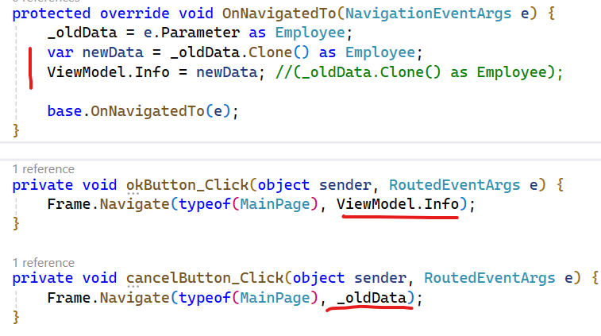
Store for later retrieval

Slide 17
NavigationView

Slide 18
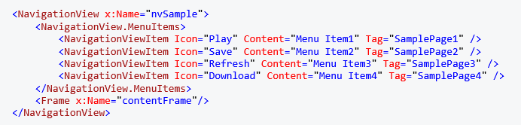
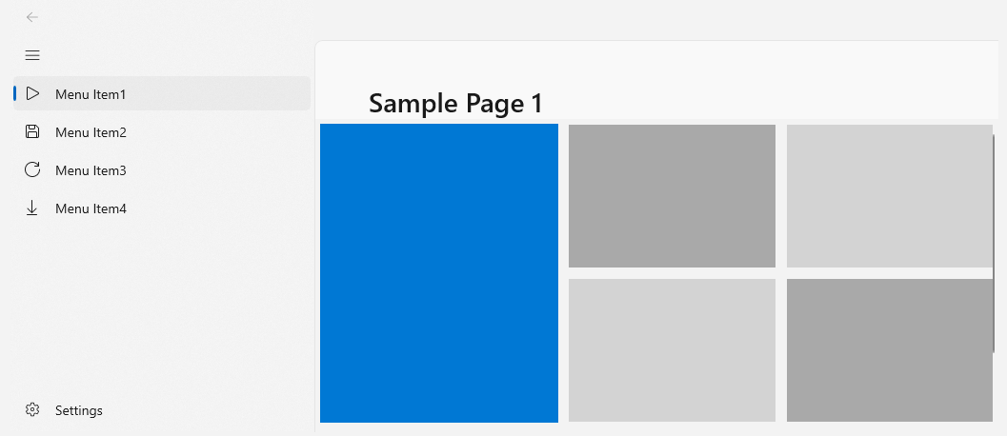
Basic NavigationView

Slide 19
NavigationView_SelectionChanged
Extract the Page name from Tag
Create type from the Page name
Navigate using Frame

Slide 20
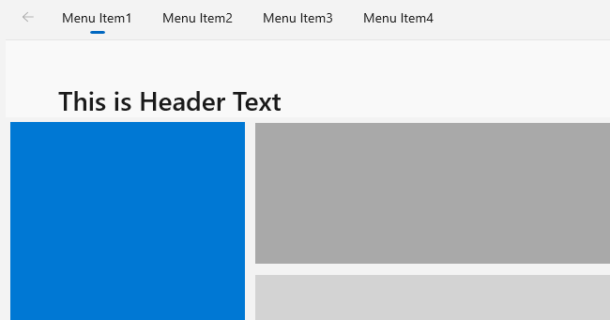
PaneDisplayMode="Top"

Slide 21
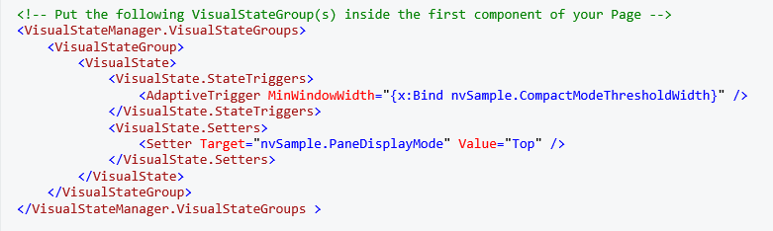
Switch panes based on window’s width

Slide 22
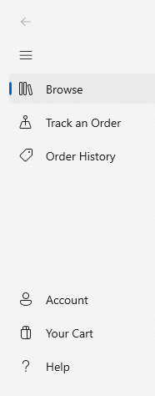

Footer menu items

